Slide 1



Idiomatic Programmer Learning Keras
Computer Vision Workshop Version: July 2019

Slide 2
Idiomatic Programmer Learning Keras
Repo: github.com/GoogleCloudPlatform/keras-idiomatic-programmer
Workshops, Handbooks, and Model Zoo

Slide 3
Computer Vision Workshop - 2019
Session 1 : Models
Session 2 : Data Engineering
Session 3 : Training & Deployment

Slide 4
Computer Vision - Models
Part 1 : Covered in Neural_Network Study Pack
Part 2 : Covered in Convolutional_Neural Network Study Pack
Part 3 : Covered in Wide_Convolutional_Neural_Networks
Part 4: Covered in Advanced_Convolutional_Neural_Networks
Part 5: Covered in Mobile_Networks

Slide 5
Computer Vision - Data Engineering
Part 6 : Covered in Data_Engineering
Part 7 : Covered in Data_Engineering
Part 8 : Covered in Data_Augmentation
Part 9 : Covered in Data_Augmentation

Slide 6
Computer Vision - Training & Deployment
Part 10 : Training Preparation & Hyperparameter Tuning
Part 11 : Training and Deployment
Part 12 : Pre-Built Models & Transfer Learning
Part 13: Production

Slide 7
Training Preparation - JSON File
Random Shuffling from a JSON File Listing
The code below demonstrates using an indirect index to randomly shuffle the dataset as a file listing in a JSON file, where the files are a list ([]) of objects, and each object has the key ‘image’.
dataset = json.load(json_file) nimages = dataset['image'] # create a sequential index between 0 and nimages-1 index = [i for i in range(nimages)] # now randomly sort the index random.shuffle(index)

Slide 8
Training Preparation - Keras
Keras ImageDataGenerator
In Keras, an image dataset can be shuffled and split into training and eval (validation) with the ImageDataGenerator class. This class is used to ingest a dataset for feeding a neural network during training. In the code example below:
The variable model refers to a Keras model that has already been compiled.
x_train and y_train refers to a processed dataset for training (i.e., already split), where x_train typically is a numpy array, with each element a preprocessed image, and y_train typically is a numpy array, with each element the corresponding one-hot encoded label.
The variable datagen is a generator, which is instantiated by ImageDataGenerator for feeding the neural network.
The method flow() sequential moves through the training data (x_train, y_train) in a specified batch size, which is specified as 32 in this example.
The parameter shuffle is set to True, which causes the training data to be shuffled by the generator, at the beginning of each epoch.
Each batch of training data is fed through the neural network using the model’s fit() method.

Slide 9
Training Preparation - Keras
Keras ImageDataGenerator
from keras.preprocessing.image import ImageDataGenerator # x_train and y_train assume the image data and labels have prior preprocessed and # split into training and test data. # instantiate an Image Data generator object datagen = ImageDataGenerator() # the number of batches in an epoch nbatches = len(x_train) // 32 # the number of epochs (training passes over the entire training data) epochs = 10 for epoch in range(epochs): batches = 0 # Use generator to create batches for x_batch, y_batch in datagen.flow(x_train, y_train, batch_size=32, shuffle=True): model.fit(x_batch, y_batch) batches += 1 if batches > nbatches: break

Slide 10
Training Preparation - Keras
Keras ImageDataGenerator - Rescale
In the code below, unlike the previous, the x_train data has not been normalized/standardized. In this case, the parameter rescale is passed to the instantiation of ImageDataGenerator, which will result in the corresponding flow() method normalizing the pixel data (i.e., dividing by 255) while the data is being fed:
from keras.preprocessing.image import ImageDataGenerator # x_train and y_train assume the image data and labels have been resized for the # CNN and split into training and test data, but the data has not been normalized. # instantiate an Image Data generator object and specify normalizing the image data datagen = ImageDataGenerator(rescale=1./255) # feed (train) the neural network

Slide 11
Training Preparation - Keras
Keras ImageDataGenerator - Standardization
In the code below, the rescale parameter is replaced with featurewise_std_normalization, which will standardize the data. Since standardization requires calculating the mean and standard deviation of the pixel data across the entire training set, a call is made the fit() method for the corresponding calculation.
from keras.preprocessing.image import ImageDataGenerator # instantiate an Image Data generator object and specify standardizing the image data datagen = ImageDataGenerator(featurewise_std_normalization=True) # calculate the mean/stddev for standardization datagen.fit(x_train) # feed (train) the neural network

Slide 12
Transfer Learning and Pre-built Models
Pre-Built Models
The Keras framework comes with a number of pre-built models, which you can use either as-is to train a new model, or modify and/or fine-tune for transfer learning. These models are based on best-in-class models for image classification, which have been award winning models in competitions like ImageNet.
The pre-built model architectures include:
Sequential CNN
VGG16, VGG19
Residual CNN
ResNet
Wide Layer CNN ResNeXt, Inception
Advanced CNN DenseNet, Xception, NASNet
Mobile
MobileNet

Slide 13
Transfer Learning and Pre-built Models
Importing Pre-Built Models
The pre-built Keras models are imported from the keras.applications module. Below are some examples:
from keras.applications import VGG16 from keras.applications import VGG19 from keras.applications import ResNet50 from keras.applications import InceptionV3 from keras.applications import InceptionResNetV2 from keras.applications import DenseNet121 from keras.applications import DenseNet169 from keras.applications import DenseNet201 from keras.applications import Xception from keras.applications import NASNetLarge from keras.applications import NASNetMobile from keras.applications import MobileNet

Slide 14
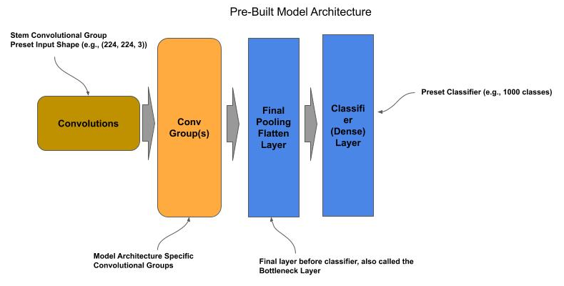
Pre-built Models
Base Model
By default, the pre-built models are complete but untrained (i.e., the weights and biases are randomly initialized). Each untrained pre-built model is configured for a specific input shape and number of output classes. In most cases the input shape is either (224, 224, 3) or (299, 299, 3). The models will also take input in channel first format as in (3, 224, 224) and (3, 299, 299). In most cases, the number of output classes is 1000.

Slide 15
Pre-built Models
Compiling the Base Model
The pre-built models do not have an assigned loss function and optimizer. Prior to using them, one must issue the compile() method to assign the loss, optimizer and performance measurements.
from keras.applications import ResNet50 # Get a pre-built ResNet50 model model = ResNet50() # Compile the model for training model.compile(loss='categorical_crossentropy', optimizer='adam', metrics=['accuracy']) # Now train the model

Slide 16
Pre-trained Models
Pre-trained Models
All of the pre-built models come with weights and biases pre-trained from ImageNet 2012 dataset; which is a dataset of 1.2 million images across 1000 classes. If your need is simply to predict if an image is within the 1000 classes of ImageNet dataset, then one can use the pre-trained pre-built models as-is.
from keras.applications import ResNet50 from keras.applications.resnet import preprocess_input, decode_predictions # Get a pre-built ResNet50 model model = ResNet50(weights='imagenet') # Read the image into memory as a numpy array image = cv2.imread('elephant.jpg', cv2.IMREAD_COLOR) # Resize the image to fit the input shape of ResNet model image = cv2.resize(image, (224, 224), cv2.INTER_LINEAR) # Preprocess the image using the same image processing used by the pre-built model image = preprocess_input(image) # Reshape from (224, 224, 3) to (1, 224, 224, 3) for the predict() method image = image.reshape((-1, 224, 224, 3)) # Call the predict() method to classify the image predictions = model.predict(image) # Display the class name based on the predicted label using the decode function for # the built-in model. print(decode_predictions(preds, top=3))

Slide 17
Pre-trained Models
New Classifier
The final classifier layer in all the pre-built models can be removed and replaced with a new classifier. The new classifier can then be used to train the pre-built model for a new dataset and set of classes.
The classifier layer is referred to as the top layer. When instantiating an instance of a pre-built model:
Set the parameter include_top to False to get an instance without the classifier.
When the include_top=False, one can also reset the input shape of the model with the parameter input_shape.

Slide 18
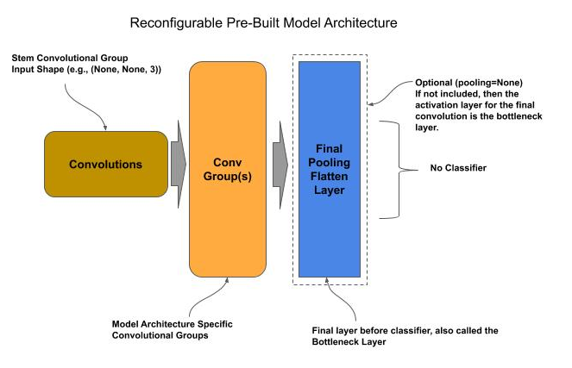
Pre-trained Models
Reconfiguring a Pre-Built Model

Slide 19
Pre-trained Models
Adding a New Classifier
In the code below, we instantiate a pre-built ResNet model and replace it with a new classifier for 20 classes:
from keras.applications import ResNet50 from keras.layers import Dense # Get a pre-built model for input shape (100,100,3) and without the classifier model = ResNet50(include_top=False, input_shape=(100, 100, 3), pooling='avg') # Add a classifier for 20 classes model.add(Dense(20, activation='softmax')) # Compile the model for training model.compile(loss='categorical_crossentropy', optimizer='adam', metrics=['accuracy']) # Now train the model

Slide 20
Pre-trained Models
Final Pooling Layer
For most models, the final layer preceding the classifier is a global average pooling layer. This layer acts as both a final pooling layer for the feature maps and a flatten operation (convert to 1D vector). One might want to replace this layer with one’s own custom final pooling/flatten layer. In this case, one either specifies the parameter pooling to None.
from keras.applications import ResNet50 from keras.layers import Dense, Flatten from keras import Model # Get a pre-built model for input shape (100,100,3) and without the classifier model = ResNet50(include_top=False, input_shape=(100, 100, 3), pooling=None) # Flatten the Feature Maps into a 1D vector output = Flatten()(model.output) # Add a classifier for 20 classes output = Dense(20, activation='softmax')(output) # Compile the model for training model = Model(model.input, output) model.compile(loss='categorical_crossentropy', optimizer='adam', metrics=['accuracy']) # Now train the model

Slide 21
Transfer Learning
Transfer Learning
Transfer learning is where one uses pretrained models for one task and retrain the classifier and/or fine-tune layers for a new task.
There are two general approaches to transfer learning:
Similar Tasks (Image Domains)
Distinct Tasks

Slide 22
Transfer Learning - Similar Tasks
Similar Tasks
When deciding on the approach, we look at the similarity of the source (pre-trained) domain of images and the destination (new) domain.
The more similar, the more of the existing bottom layers we can reuse without training.
For example, if one had a model trained on fruits, it’s probably that all of the bottom layers of the pretrained model can be reused (without retraining) for building a new model to recognize vegetables.

Slide 23
Transfer Learning - Similar Tasks
Similar Tasks
For similar tasks, we assume that:
The coarse features learned at the bottom-most layers will be the same for the new classifier,
The grouping of coarse features in the middle layers and final assembly into details all can be reused as-is, prior to entering the topmost layer(s) for classification.
When the source and destination domains have this high level of similarity, we generally can:
Replace the existing topmost classifier layer with a new classifier layer,
Freeze the lower layers and train only the classifier layer.
Since we don’t need to learn the weights/biases for the other layers, we can generally train a model for the new domain with substantially less data and fewer epochs.

Slide 24
Transfer Learning - Similar Tasks
Similar Tasks - Dataset Size
Transfer learning between similar source and destination domains provides the ability to train with substantially smaller datasets. The two most general best practices for the minimum size of the dataset are:
Each class (label) is 10% as big as in the source dataset.
Each class (label) has at least 100 images.

Slide 25
Transfer Learning - Similar Tasks
Similar Tasks - Freezing Layers
We modify the code to freeze all the layers preceding the topmost classifier layer prior to training. Freezing prevents the weights/biases of the layer(s) from being updated during training.
In Keras, each layer has the property freeze, which defaults to True.
Use a pre-built model with pre-trained weights/biases (ImageNet 2012),
Drop the existing classifier from the pre-built model (topmost layer).
Freeze the remaining layers.
Add a new classifier layer.
Train the model through transfer learning.

Slide 26
Transfer Learning - Similar Tasks
Retraining a ResNet-50 Model
from keras.applications import ResNet50 from keras.layers import Dense from keras import Model # Get a pre-trained/pre-built model without the classifier and retain the global # average pooling # layer following the final convolution (bottleneck) layer model = ResNet50(include_top=False, pooling='avg', weights='imagenet') # Freeze the weights of the remaining layer for layer in model.layers: layer.trainable = False # Add a classifier for 20 classes output = Dense(20, activation='softmax')(model.output) # Compile the model for training model = Model(model.input, output) model.compile(loss='categorical_crossentropy', optimizer='adam', metrics=['accuracy']) # Now train the model

Slide 27
Transfer Learning - Distinct Tasks
Distinct Tasks
When the source and destination domain of the image datasets are non-similar, one starts with the same steps as in the similar task approach above, but then follows up with fine-tuning the bottom layers. The steps in this approach generally are:
Add a new classifier layer and freeze the remaining layer.
Train the new classifier layer the target number of epochs.
Repeat for fine-tuning:
Unfreeze the next bottom-most convolutional group
(moving in direction of top to bottom)
Train for a few epochs to fine-tune.
Once the convolutional groups are fine-tuned:
Unfreeze the convolutional stem group
Train for a few epochs to fine-tune

Slide 28
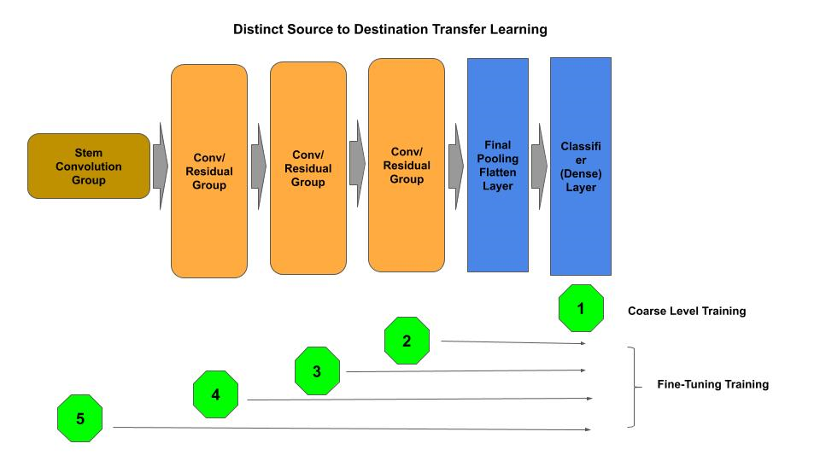
Transfer Learning - Distinct Tasks
Distinct Tasks - (Re)Training Overview

Slide 29
Transfer Learning - Distinct Tasks
Transfer Learning - Coarse Training
In the next code example, we start with a a coarse training for the add classifier level, followed by fine-tuning of each convolutional (residual) group and finally the stem convolutional group.
# Deleted for brevity ... # Freeze the weights of the remaining layer for layer in model.layers: layer.trainable = False # Add a classifier for 20 classes output = Dense(20, activation='softmax')(model.output) # Compile the model for training model = Model(model.input, output) model.compile(loss='categorical_crossentropy', optimizer='adam', metrics=['accuracy']) # Coarse Level Training of the classifier model.fit(x_data, y_data, batch_size=32, epochs=50, validation_split=0.2)

Slide 30
Transfer Learning - Distinct Tasks
Transfer Learning - Finer Training
Next we will do the fine-tuning of each convolutional (residual) group. The first step below, we scan through the model building a list of the residual groups, and convolutional layers within the group, in sequential order.
stem = None # layer that is the convolutional layer for the stem group groups = [] # the add layer for each convolutional group conv2d = [] # the convolutional layers of a group first_conv2d = True for layer in model.layers: if type(layer) == layers.convolutional.Conv2D: # In ResNet50, the first Conv2D is the stem convolutional layer if first_conv2d == True: stem = layer first_conv2d = False # Keep list of convolutional layers per convolutional group else: conv2d.append(layer) # Each convolutional group in Residual Networks ends with a Add layer. # Maintain list in reverse order (top-most conv group is top of list) elif type(layer) == layers.merge.Add: groups.insert(0, conv2d) conv2d = []

Slide 31
Transfer Learning - Distinct Tasks
Transfer Learning - Finer Training
Next, we fine-tune train each convolutional group, sequentially from the top-most group proceeding to the bottom-most, for a smaller number of epochs (5) than the coarse training. Finally, we fine-tune train the stem convolutional group.
# Unfreeze a convolutional group at a time (from top-most to bottom-most) # And fine-tune (train) that layer for i in range(1, len(groups)): # Unfreeze the convolutional layers in this conv/residual group for layer in groups[i]: layer.trainable = True # re-compile the model for training model.compile(loss='categorical_crossentropy', optimizer='adam', metrics=['accuracy']) # Fine-tune train the convolutional group(s) model.fit(x_data, y_data, batch_size=32, epochs=5) # Unfreeze the stem convolutional and do a final fine-tuning stem.trainable = True model.compile(loss='categorical_crossentropy', optimizer='adam', metrics=['accuracy']) model.fit(x_data, y_data, batch_size=32, epochs=5, validation_split=0.2)

Slide 32
Transfer Learning - Domain Training
Domain Specific Weights
One may desire to have pre-trained weights from a specific domain, other than the ImageNet 2012. In the next code example, we:
first train a ResNet50 pre-built architecture for a specific domain (e.g., produce),
and then subsequently use the pretrained domain specific weights and initialization to train another ResNet50 model in a similar domain.
Steps:
Instantiate an uninitialized ResNet50 model without the classifier and pooling layer, which we designate as the base model.
Save the base model architecture for later reuse in transfer learning (produce-model.json).
model = ResNet50(include_top=False, pooling=None, input_shape=(100, 100, 3)) # save the base model base_model = model.to_json()# Write the JSON string to a file with open('produce-model.json', 'w') as f: f.write(base_model)

Slide 33
Transfer Learning - Domain Training
Domain Specific Weights - Train for a Specific Domain
Next, we:
Add a classifier (Flatten and Dense layers) and train for a specific (source) domain (e.g., produce).
Save the weights for the trained model (produce-weights.h5)
# Add classifier output = Flatten(name='bottleneck')(model.output) output = Dense(20, activation='softmax')(output) # do training here # save the model weights model.save_weights('produce-weights.h5')

Slide 34
Transfer Learning - Domain Training
Domain Specific Weights - Transfer Train for New Domain
Finally, we:
Load the base model architecture (`model-produce.json), which does not contain the classifier layer.
Initialize the base model architecture with the pretrained weights for the source domain (model-produce.h5).
Add a classifier for the new similar domain.
Train the model/classifier for the new similar domain.
# Read the JSON string for the base model from a file with open('produce-model.json', 'r') as f: base_model = f.read() # Reuse the base model and trained weights model = model_from_json(base_model) model.load_weights('produce-weights.h5') # Add classifier output = Flatten(name='bottleneck')(model.output) output = Dense(20, activation='softmax')(output) # Compile the model model = Model(model.input, output) model.compile(loss='categorical_crossentropy', optimizer='adam', metrics=['accuracy']) # train the new model for a new dataset

Slide 35
Transfer Learning - Domain Initialization
Domain Transfer Weight Initialization
Another form of transfer learning, is transfer of domain specific weights to use as weight initialization in a model one will otherwise fully retrain. In this case, one is trying to improve on using an initializer based on a random weight distribution algorithm (e.g., Xavier for tanh and He-Normal for ReLU activation functions).
Transferring of domain specific weights is a one-shot weight initialization approach. The presumption is to generate a set of weight initialization that is generalized enough that the training of the model will lead to the best local (or global) optima. What one wants to accomplish is to do some initial training of a model, that the weights learned during the initial session will have the characteristics of:
Will point in the general right direction for convergence, and
Be over generalized to prevent diving into an arbitrary local optima.
Such that these weights can be used as the initialization weights for a single (one-shot) training session which will converge on the best local optima.

Slide 36
Transfer Learning - Domain Initialization
Domain Transfer Weight Initialization - Code Example Part 1
The steps for this form of weight initialization are:
Instantiate a model, with a random weight distribution (Xavier, He-Normal, etc).
Use high level of dropout and/or regularization to prevent fitting to the data.
Run a few epochs.
Save the weights.
Start a full training session using the saved weights.
# Instantiate base model with default weight initialization (i.e., He-Normal) model = ResNet50(include_top=False, pooling=None, input_shape=(100, 100, 3)) # save the base model base_model = model.to_json()# Write the JSON string to a file with open('model.json', 'w') as f: f.write(base_model) # Add a dropout layer and classifier to the base ResNet Model output = layers.Dropout(0.75)(model.output) output = layers.Dense(20, activation='softmax')(output) model = Model(model.input, output) # do pre-training here for a few epochs (e.g., 5 epochs) # save the model weights as the weight initializer

Slide 37
Transfer Learning - Domain Initialization
Domain Transfer Weight Initialization - Code Example Part 2
model.save_weights('weights-init.h5') # Read the JSON string for the base model from a file with open('model.json', 'r') as f: base_model = f.read() # Reuse the base model model = model_from_json(base_model) # Initialize the weights using domain transfer weight initialization model.load_weights('weights-init.h5') # Add classifier without Dropout output = Dense(20, activation='softmax')(model.output) model = Model(model.input, output) model.compile(loss='categorical_crossentropy', optimizer='adam', metrics=['accuracy']) # train the new model

Slide 38
Negative Transfer
Negative Transfer
In some cases one will find that transfer learning results in a more negative performance, than training from scratch. That is, when using a pre-trained model to train a new model, the overall performance during training is less than what it would be if the model was not pre-trained.
This is referred to as negative transfer. In this case, the source and destination domains as so distinct, that the learned weights for the source domain cannot be reused on the destination domain, and when reused the training of the model will not converge, and quite possibly diverge.
In general, one can spot negative transfer usually within five to ten epochs.

Slide 39
Production
TBD

